Slide 1
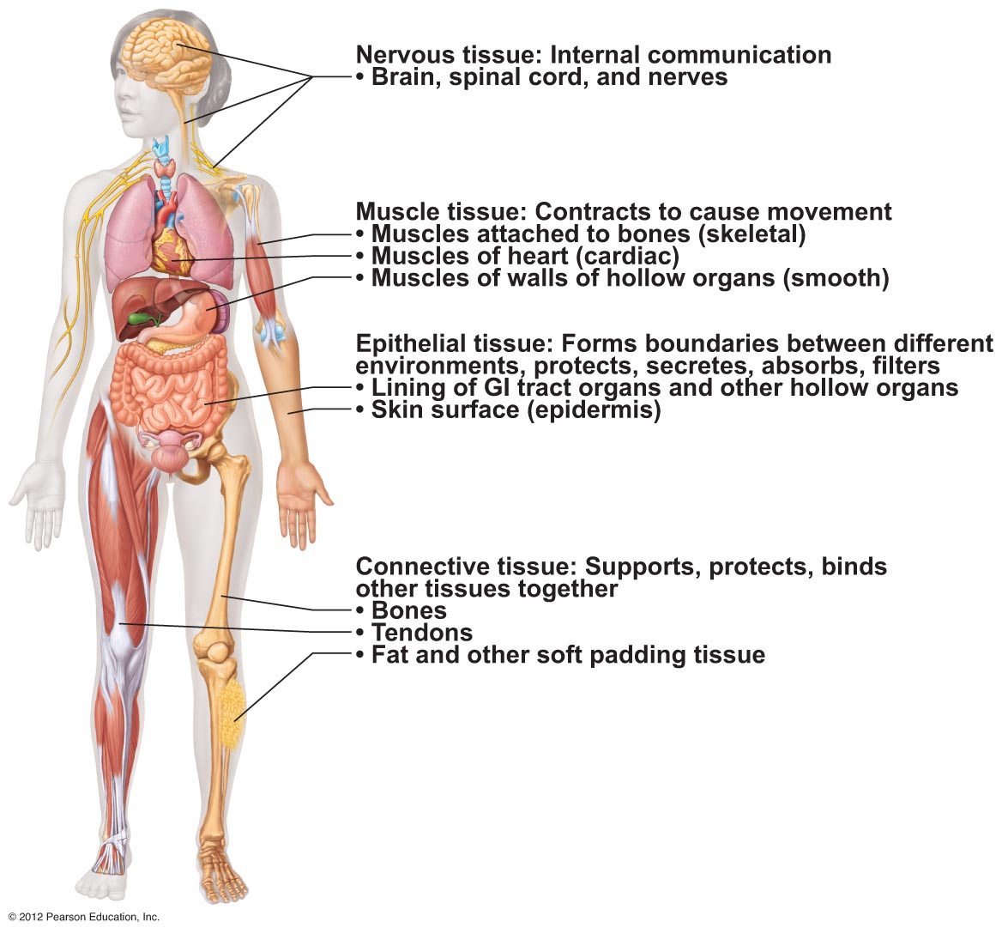
Body Tissues
Tissues
Groups of cells with similar structure and function
Four primary types
Epithelial tissue
(epithelium)
Connective tissue
Muscle tissue
Nervous tissue

Slide 2
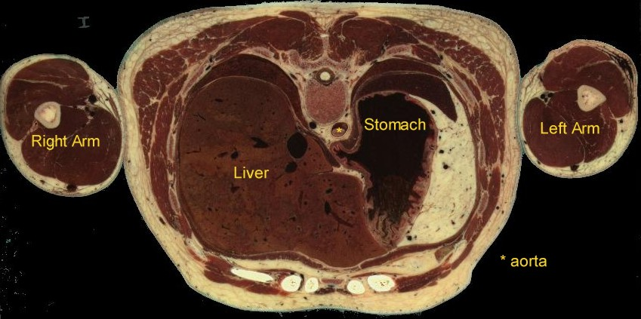
Epithelial Tissues
Locations
Body coverings
Body linings
Glandular tissue
Functions
Protection
Absorption
Filtration / Excretion
Secretion
Notes:
List some body linings & discuss their function – Ex: skin, stomach, lungs, mouth, esophagus, intestines, arteries, trachea. Discuss what size, shape, special functions some of these cells would need to have.

Slide 3
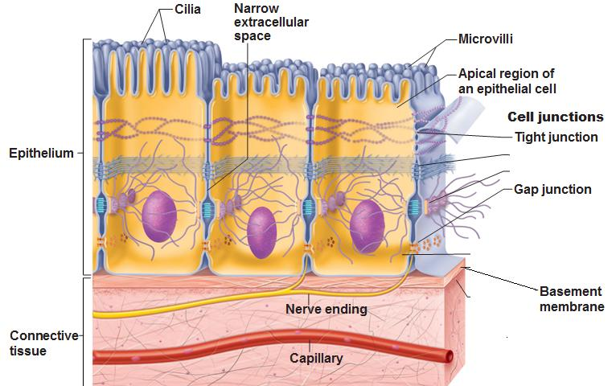
Epithelium Characteristics
Cells fit closely together and often form sheets
Tight junctions
The apical surface is the free surface of the tissue
The lower surface of the epithelium rests on a basement membrane (acellular)
Avascular (no blood supply)
Regenerate easily if well nourished
Through what process?

Slide 4
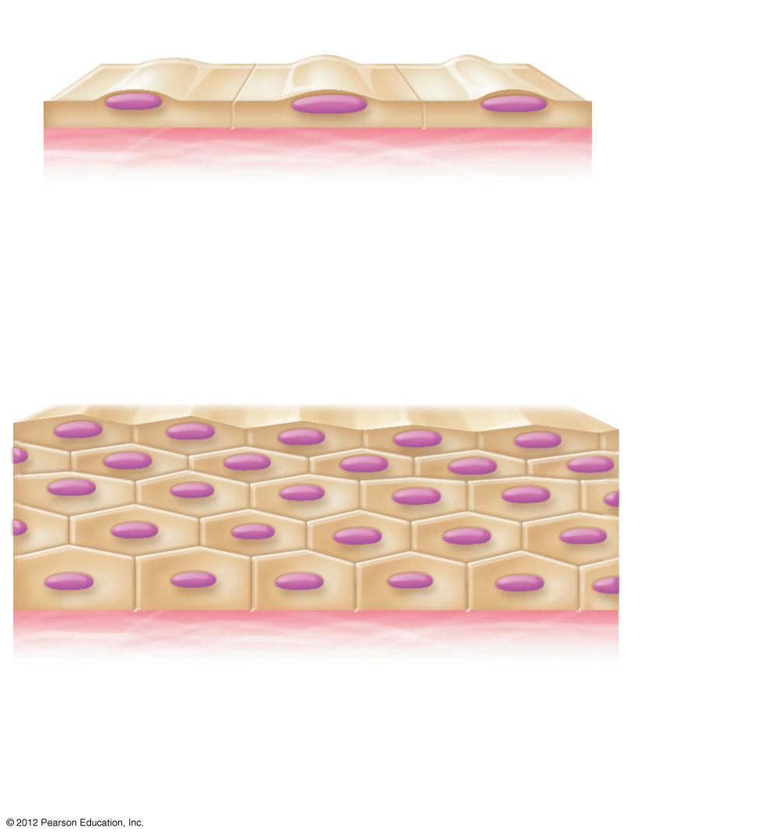
Classification of Epithelia
Number of cell layers
Simple—one layer
Stratified—more than one layer
Apical surface
Basal
surface
Simple
Apical surface
Basal
surface
Stratified
(a) Classification based on number of cell layers
Figure 3.17a
Notes:
How can you remember stratified means more than one layer?

Slide 5
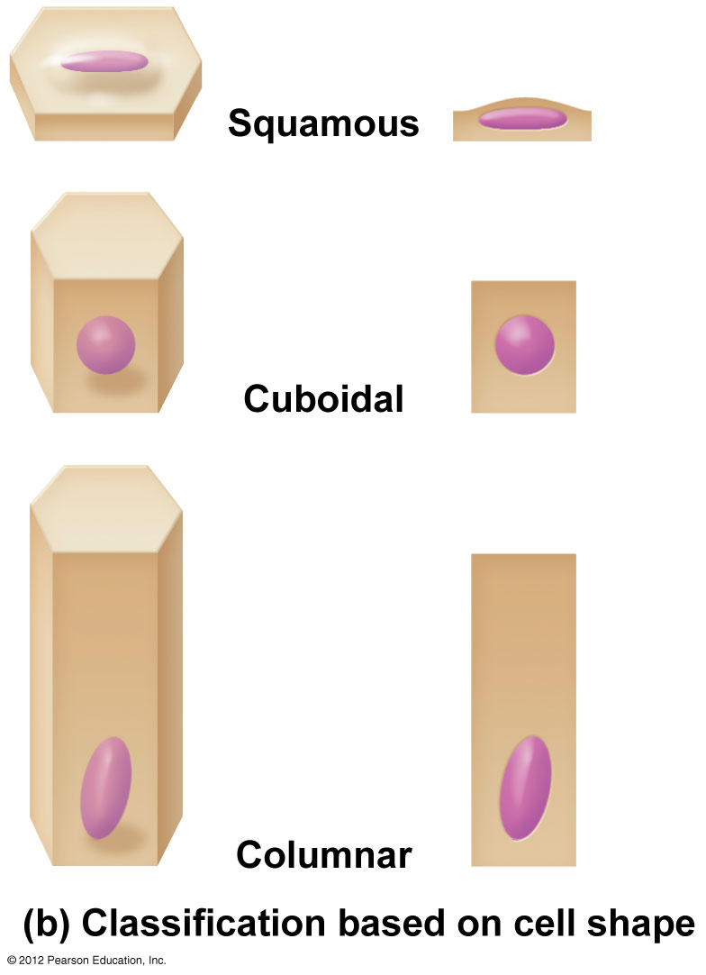
Classification of Epithelia
Shape of cells
Squamous
flattened
Cuboidal
cube-shaped
Columnar
column-like

Slide 6
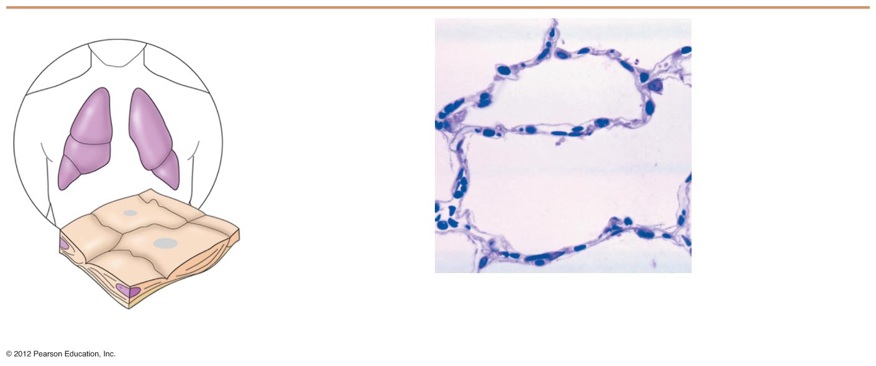
Simple Epithelia
Simple squamous
Single layer of flat cells
Location - usually forms membranes
Lines body cavities
Lines lungs and capillaries
Functions in diffusion, filtration, or secretion in membranes
g
http://www.youtube.com/watch?v=d-f3RL0KiUg

Slide 7
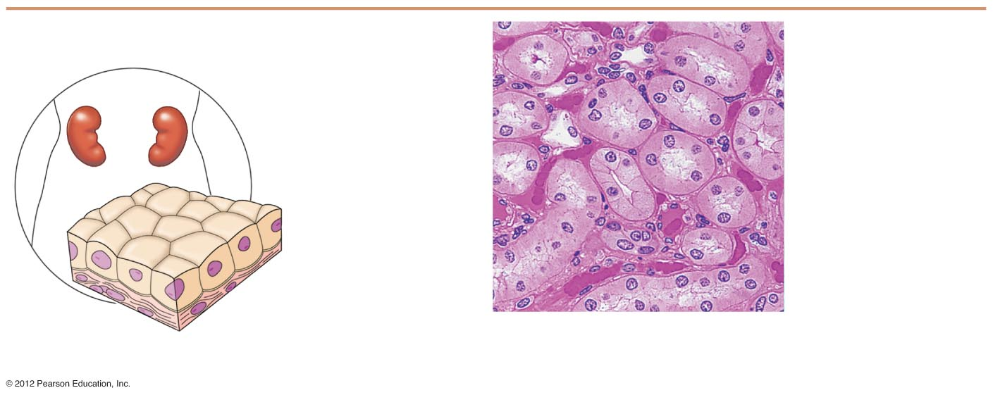
Simple Epithelia
Simple cuboidal
Single layer of cube-like cells
Locations
Common in glands and their ducts (ex: salavary glands)
Forms walls of kidney tubules
Covers the ovaries
- Functions – secretion & absorption
Nucleus of
simple
cuboidal
epithelial
cell
Simple
cuboidal
epithelial
cells
Basement
membrane
Basement
membrane
Connective
tissue
Photomicrograph: Simple cuboidal
epithelium in kidney tubules (250×).
(b) Diagram: Simple cuboidal

Slide 8
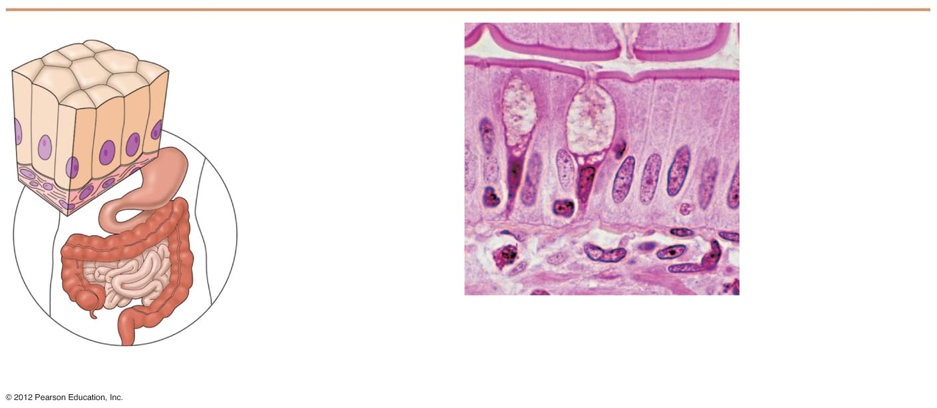
Simple Epithelia
http://www.youtube.com/watch?v=u7yGj6i5lBA
Video shows brush border of small intestine
Simple columnar
Single layer of tall cells
Often includes mucus-producing goblet cells
Location - lines digestive tract
Functions in secretion and absorption; those located in intestines contain microvilli to increase the surface area for more absorption.
http://www.youtube.com/watch?v=tYCLligRoMY
Simple
columnar
epithelial
cell
Nucleus of simple
columnar epithelial cell
Goblet cell
Basement
membrane
Connective
tissue
Basement
membrane
Photomicrograph: Simple columnar
epithelium of the small intestine
(430×).
(c) Diagram: Simple columnar

Slide 9
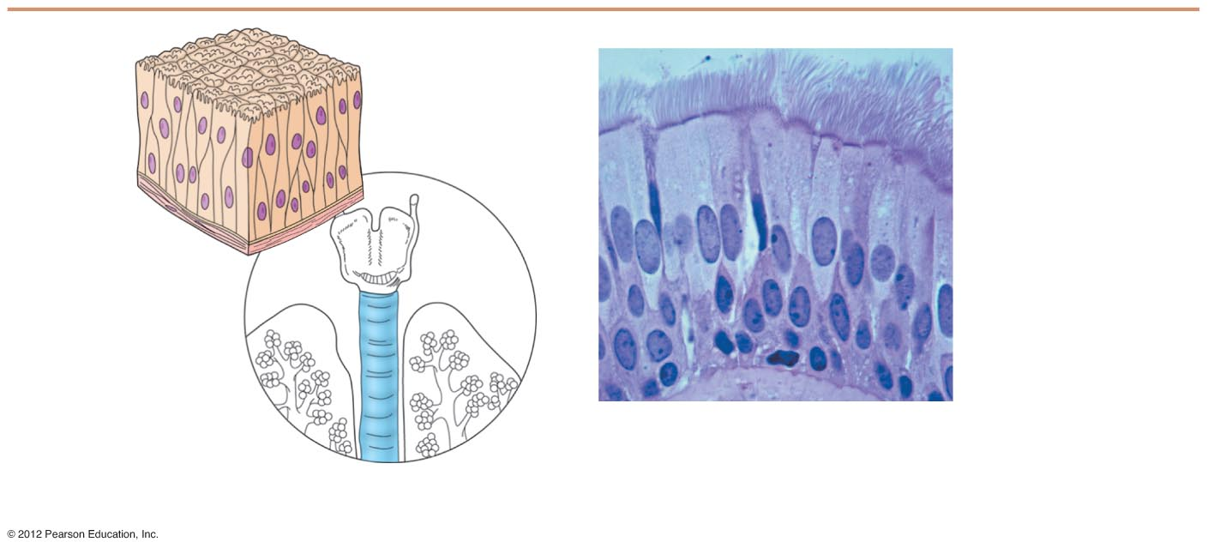
Simple Epithelia
Pseudostratified columnar
Single layer, but some cells are shorter than others
Often looks like a double layer of cells but all cells rest on the basement membrane
Location - respiratory tract, where it is ciliated
Functions in absorption or secretion; contain goblet cells for secretion of mucus
http://www.youtube.com/watch?v=FQwqhblxz3I
http://www.youtube.com/watch?v=miEEluVlemQ
Video shows epithelial tissue lining trachea
Cilia
Pseudo-
stratified
epithelial
layer
Pseudo-
stratified
epithelial
layer
Basement
membrane
Basement
membrane
Connective
tissue
Photomicrograph: Pseudostratified
ciliated columnar epithelium lining
the human trachea (430×).
(d) Diagram: Pseudostratified (ciliated)
columnar

Slide 10
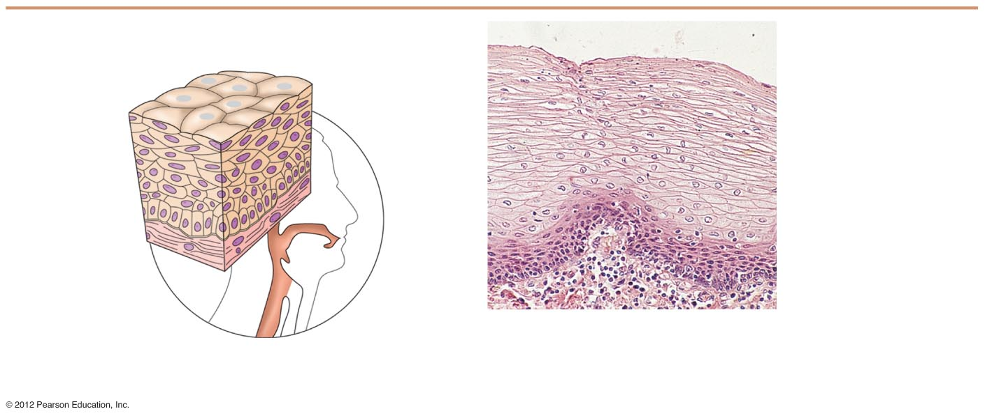
Stratified Epithelia
Stratified squamous
Cells at the apical surface are flattened
Functions as a protective covering where friction is common
Locations - lining of the:
Skin
Mouth
Esophagus
Nuclei
Stratified
squamous
epithelium
Stratified
squamous
epithelium
Basement
membrane
Basement
membrane
Photomicrograph: Stratified
squamous epithelium lining of
the esophagus (140×).
Connective
tissue
(e) Diagram: Stratified squamous

Slide 11
Stratified Epithelia
Stratified cuboidal—two layers of cuboidal cells; functions in protection
Stratified columnar —surface cells are columnar, cells underneath vary in size and shape; functions in protection
Both rare in humans

Slide 12
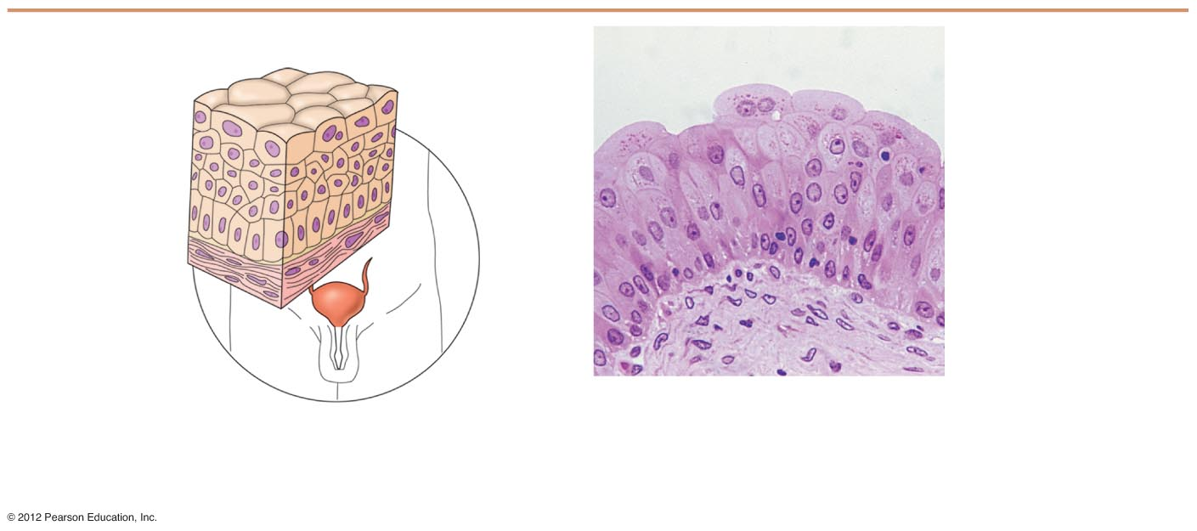
Stratified Epithelia
Transitional epithelium
Composed of modified stratified squamous epithelium
Functions in stretching and the ability to return to normal shape
Location - lines organs of the urinary system

Slide 13
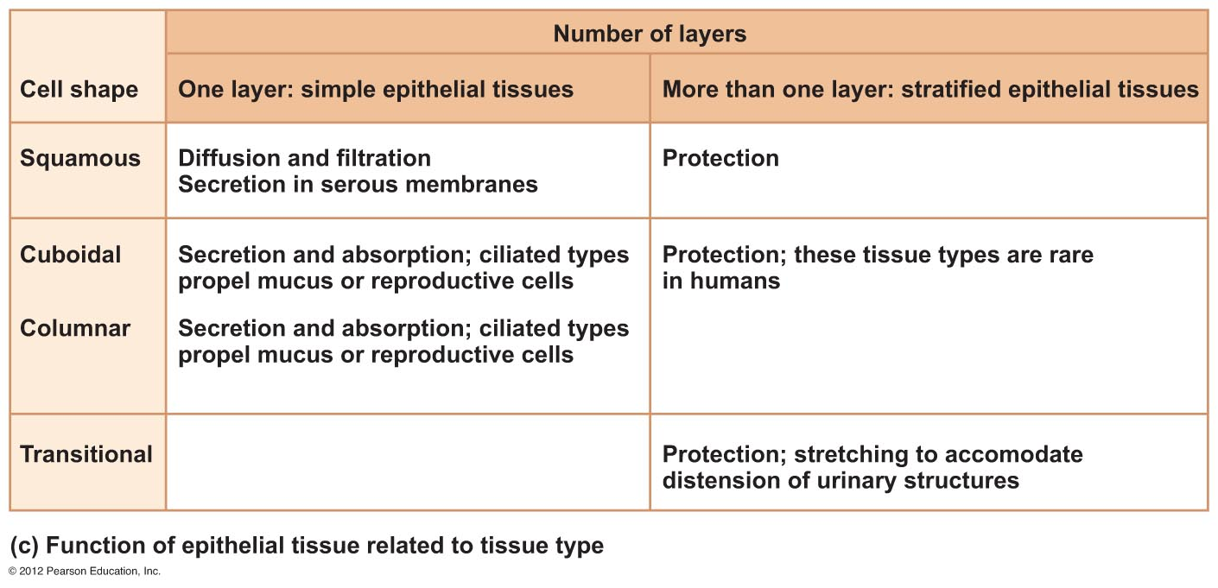

Slide 14
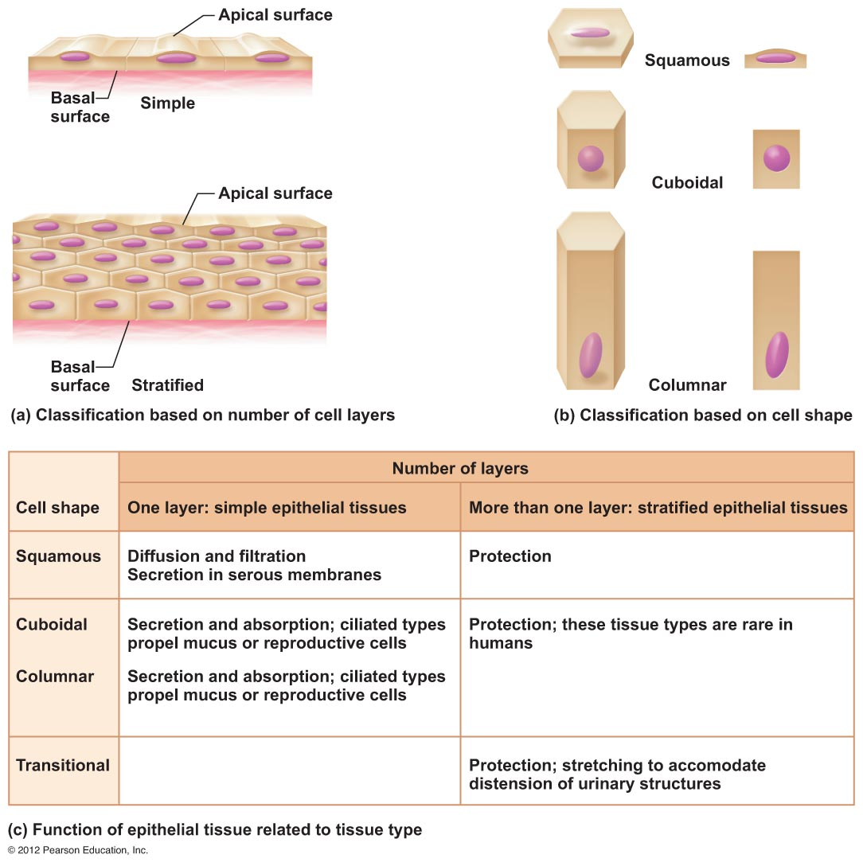

Slide 15
Glandular Epithelium
Gland
One or more cells responsible for secreting a particular product
Secretions contain protein molecules in an aqueous (water-based) fluid

Slide 16
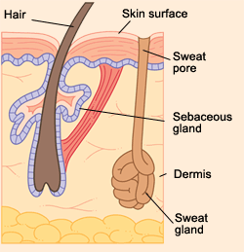
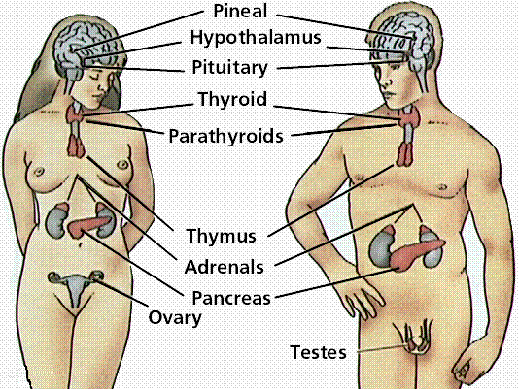
Glandular Epithelium
Two major gland types
Endocrine gland
Ductless since secretions diffuse into blood vessels
All secretions are hormones
Exocrine gland
Secretions empty through ducts to the epithelial surface
Include sweat and oil glands

Slide 17
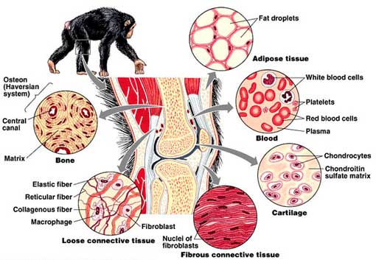
Connective Tissue
Found everywhere in the body
Functions
Binds body tissues together
Supports the body
Provides protection

Slide 18
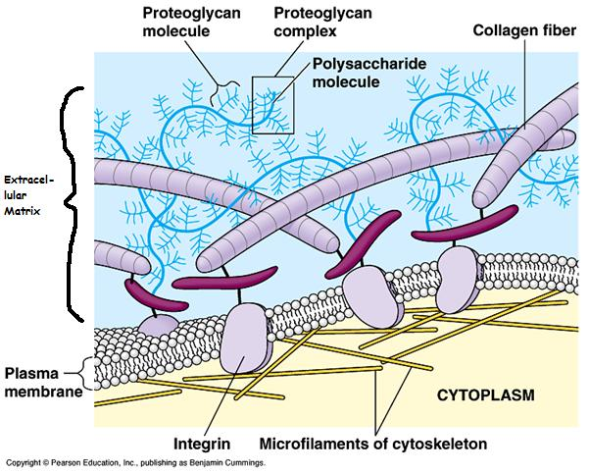
Connective Tissue Characteristics
Most are vascular (except tendons, ligaments & cartilage)
The cells of this tissue have many different types of fibers attached to the cell membrane called Extracellular Matrix (ECM) which can vary from very solid (bone) to liquid (blood)
Non-living material that surrounds living cells

Slide 19
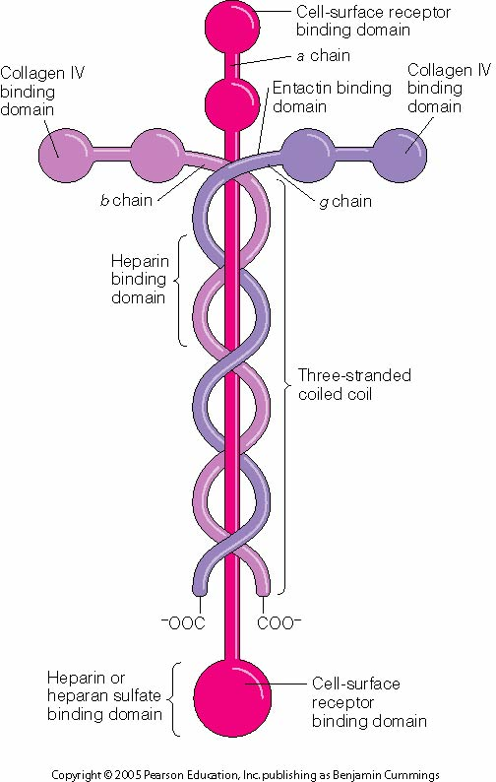
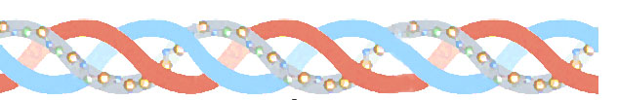
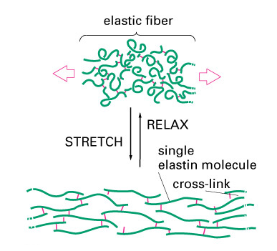
Extracellular Matrix Fibers
There are different types but we will focus on collagen fibers which are very strong. There are also elastin fibers which provide elasticity & laminin fibers which help bind tissues (keep them together).

Slide 20
Connective Tissue Types – classified based on the types of cells & the matrix (fibers) surrounding the cells
Types Include:
Bone (osseous tissue)
Cartilage
Dense (Fibrous)Connective tissue (ligaments, tendons)
Loose Connective tissue (areolar & adipose)
Blood

Slide 21
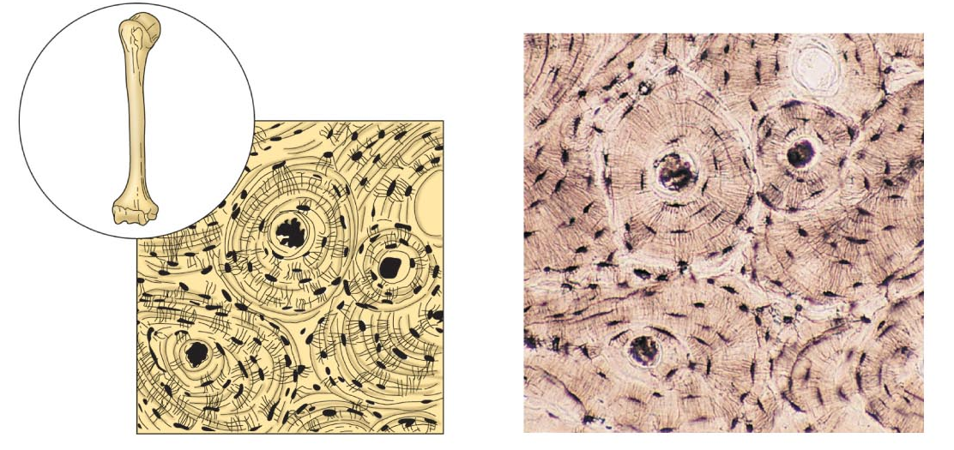
Connective Tissue Types
Bone
Composed of
Bone cells in lacunae (cavities)
Hard matrix of calcium salts
Large numbers of collagen fibers
Functions to protect and support the body

Slide 22
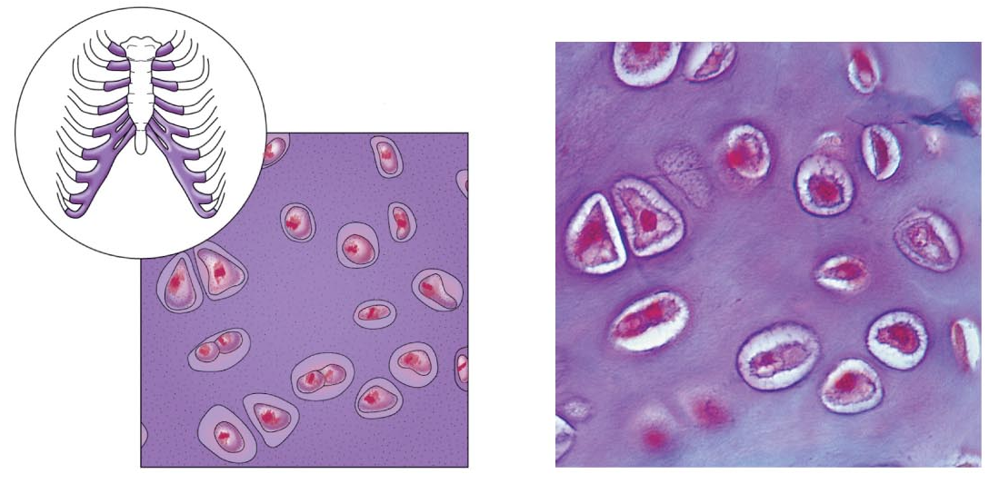
Connective Tissue Types
Cartilage
Composed of
Rubbery matrix b/t cells
Locations
Larynx
Entire fetal skeleton prior to birth
External ear
Joints
Functions as a more flexible skeletal element than bone

Slide 23
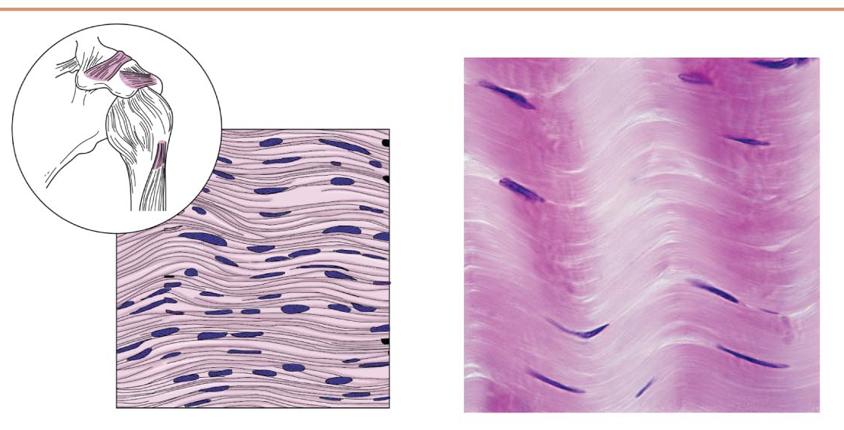
Connective Tissue Types
Dense connective tissue
Contains Fibroblasts - cells that make fibers such as collagen
Locations
Tendons—attach skeletal muscle to bone
Ligaments—attach bone to bone at joints
Dermis—lower layers of the skin

Slide 24
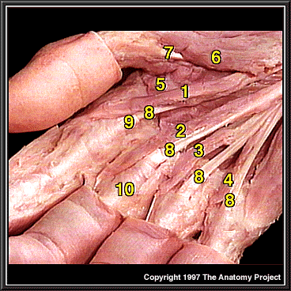
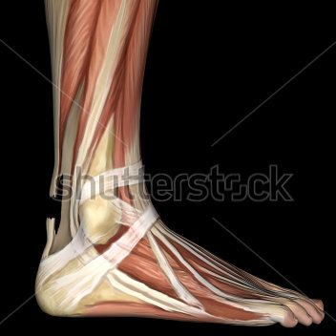
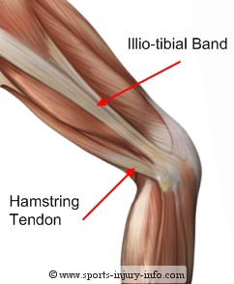
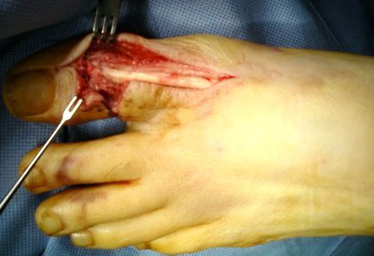

Slide 25
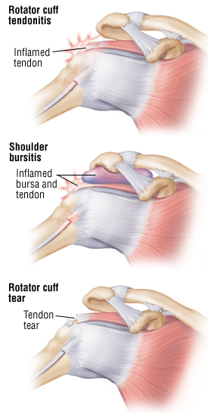
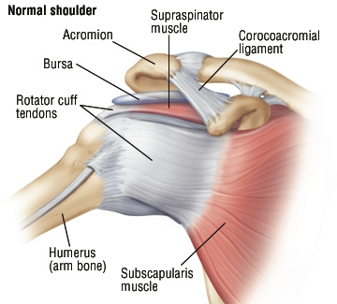

Slide 26
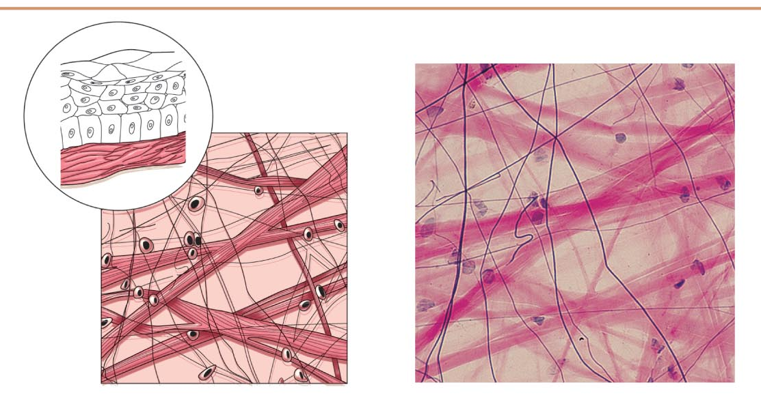
Connective Tissue Types
Loose connective tissue types
Areolar tissue
Under epithelial tissue
Soft, pliable tissue
Can soak up excess fluid (causes edema)

Slide 27
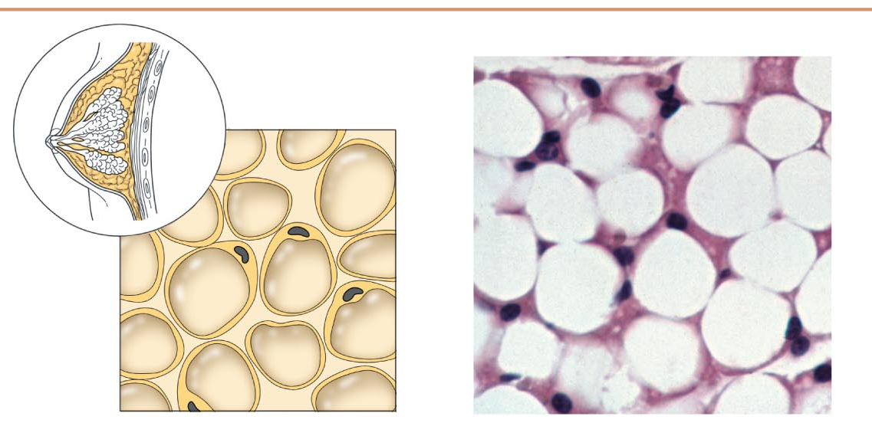
Connective Tissue Types
Loose connective tissue types
Adipose tissue
Many cells contain large lipid deposits
Functions
Insulates the body
Protects some organs
Serves as a site of fuel storage

Slide 28
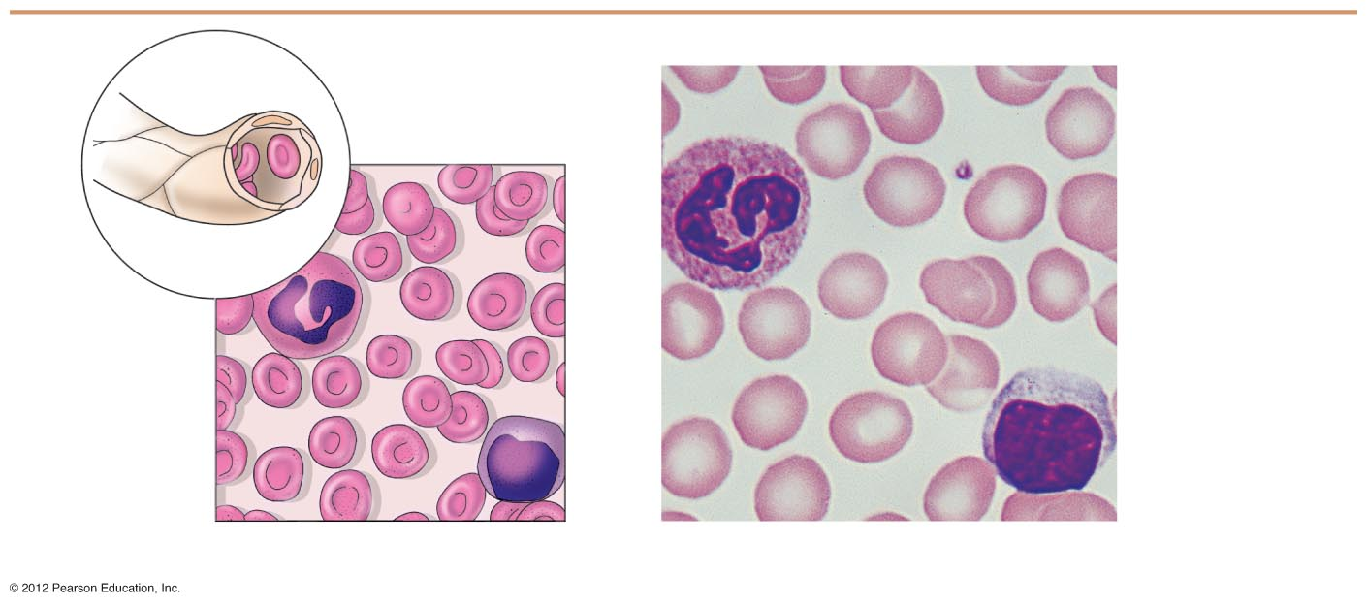
Connective Tissue Types
Blood (vascular tissue)
Blood cells surrounded by fluid matrix called blood plasma
Fibers are visible during clotting
Functions as the transport vehicle for materials

Slide 29
Connective Tissue
Connective Tissue Type | Cell type & or matrix composition | Functions | Location in the body | Extra Notes
Bone
Cartilage
Dense Connective Tissue
Loose Connective Tissue - Areolar
Loose Connective Tissue - Addipose
Blood

Slide 30
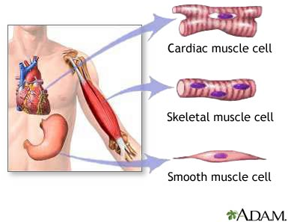
Muscle Tissue
Function is to produce movement
Three types
Skeletal muscle
Cardiac muscle
Smooth muscle

Slide 31
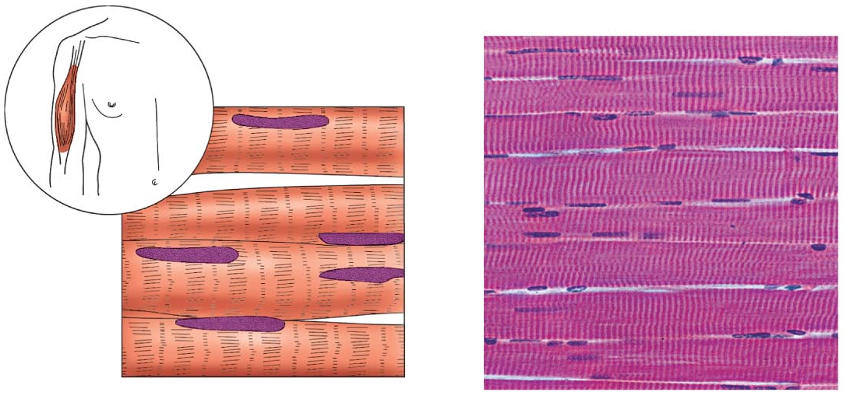
Muscle Tissue Types
Skeletal muscle
Under voluntary control
Contracts to pull on bones or skin
Produces gross body movements or facial expressions
Characteristics of skeletal muscle cells
Striated (stripes)
Multinucleate (more than one nucleus)
Long, cylindrical cells

Slide 32
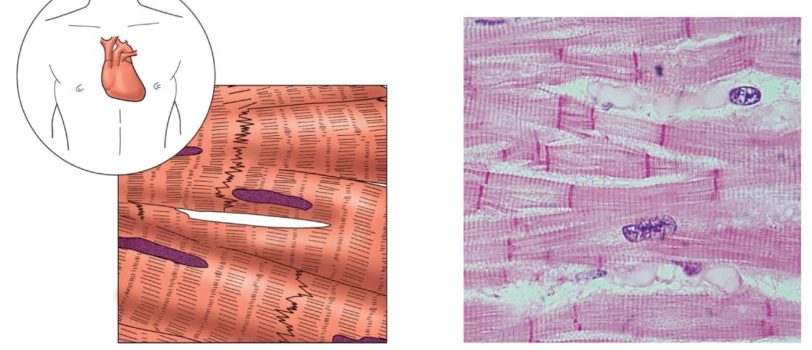
Muscle Tissue Types
Cardiac muscle
Under involuntary control
Found only in the heart
Function is to pump blood
Characteristics of cardiac muscle cells
Striated
One nucleus per cell
Cells are attached to other cardiac muscle cells at intercalated disks

Slide 33
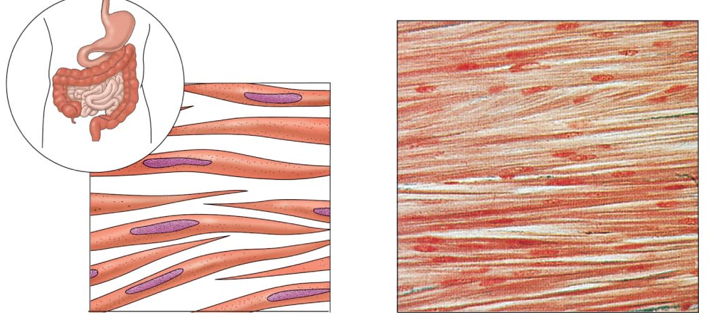
Muscle Tissue Types
Smooth muscle
Under involuntary muscle
Found in walls of hollow organs such as stomach, uterus, and blood vessels
Characteristics of smooth muscle cells
No visible striations
One nucleus per cell
Spindle-shaped cells

Slide 34
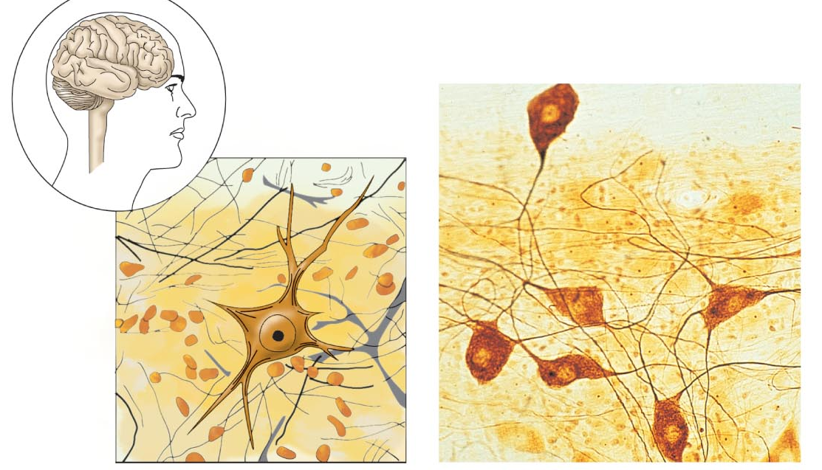
Nervous Tissue
Composed of neurons and nerve support cells
Function is to send impulses to other areas of the body
Irritability
Conductivity
Support cells called neuroglia insulate, protect, and support neurons
Location – brain, spinal cord, throughout body tissues

Slide 35
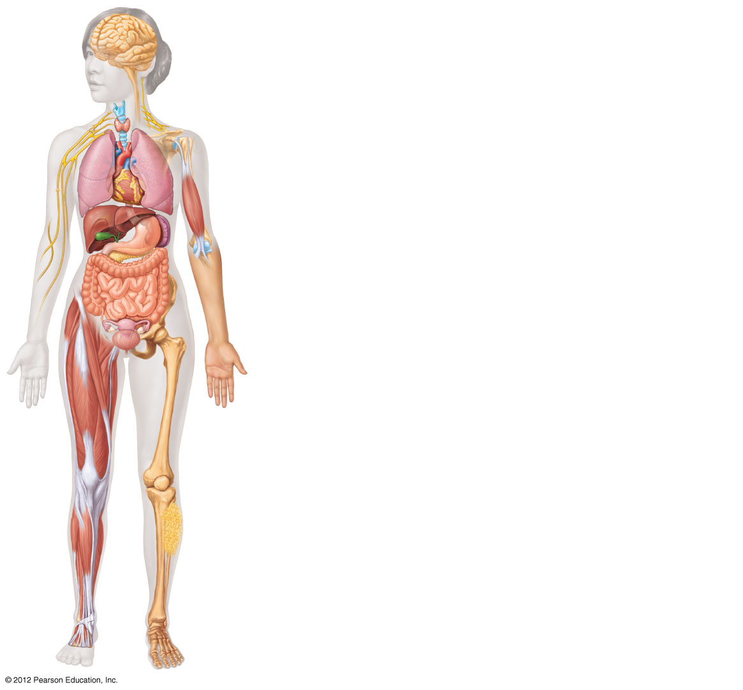
Nervous tissue: Internal communication
• Brain, spinal cord, and nerves
Muscle tissue: Contracts to cause movement
• Muscles attached to bones (skeletal)
• Muscles of heart (cardiac)
• Muscles of walls of hollow organs (smooth)
Epithelial tissue: Forms boundaries between different
environments, protects, secretes, absorbs, filters
• Lining of GI tract organs and other hollow organs
• Skin surface (epidermis)
Connective tissue: Supports, protects, binds
other tissues together
• Bones
• Tendons
• Fat and other soft padding tissue
Figure 3.22

Slide 36
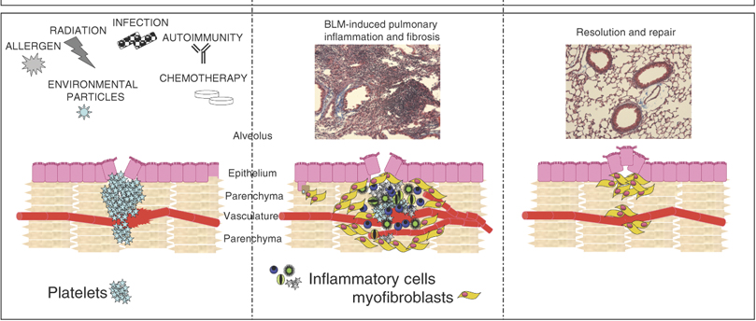
Tissue Repair (Wound Healing)
Regeneration
Replacement of destroyed tissue by the same kind of cells
Fibrosis
Repair by dense (fibrous) connective tissue (scar tissue)
Whether regeneration or fibrosis occurs depends on:
Type of tissue damaged
Severity of the injury

Slide 37
Events in Tissue Repair
Inflammation
Capillaries become very permeable (leaky)
Clotting proteins migrate into the area from the blood stream
A clot walls off the injured area
Granulation tissue forms
Growth of new capillaries
Rebuild collagen fibers
Regeneration of surface epithelium
Scab detaches

Slide 38
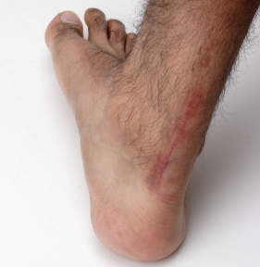
Regeneration of Tissues
Tissues that regenerate easily
Epithelial tissue (skin and mucous membranes)
Fibrous connective tissues and bone
Tissues that regenerate poorly
Skeletal muscle
Tissues that are replaced largely with scar tissue
Cardiac muscle
Nervous tissue within the brain and spinal cord

Slide 39
http://www.health-news-for-you.com/scar-tissue.html
Scar tissue article

